Slide 1

NETWORKING
By.Harsha Vardhan.S

Slide 2
What is networking? Networking is the process of connecting computers, servers, and other devices to share data, resources, and services. PAN:-personal area network LAN:- local area network WAN:-wide area network MAN:-metropolitan area network CAN:-campus area network

Slide 3
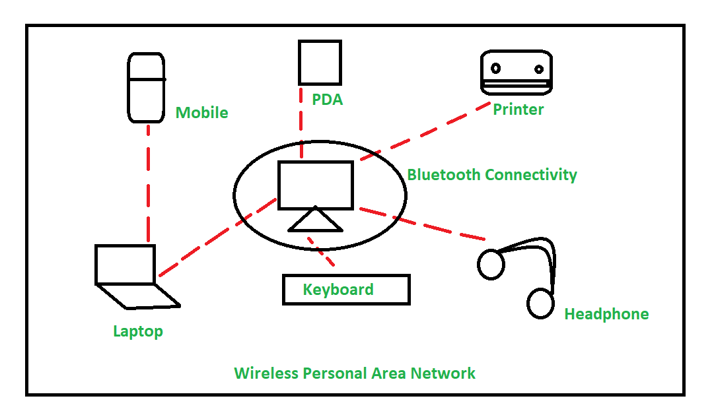
DAIGRAM of PAC
PAN:-PERSONAL AREA NETWORK

Slide 4
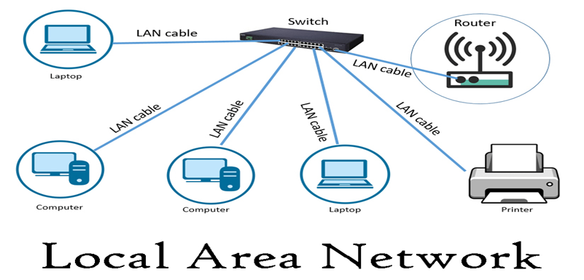
LAC:- local area network
A Local Area Network (LAN) connects computers and devices within a limited geographic area like a home, school, or office building. It allows resources (like files, printers, and internet) to be shared among multiple devices.

Slide 5
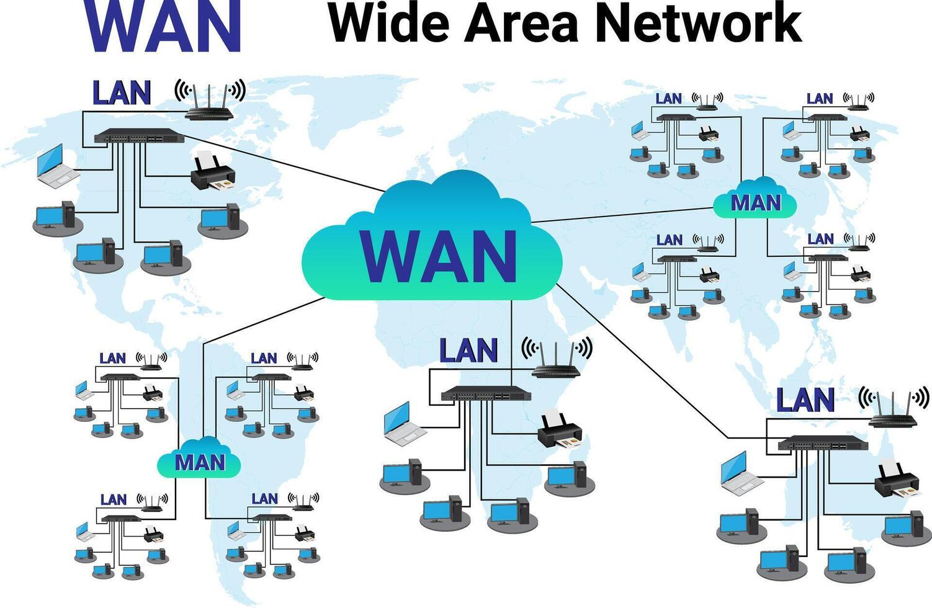
WAC:- wide area network
A Wide Area Network (WAN) is a telecommunications network that extends over a large geographic area — such as a city, country, or even globally. It connects multiple LANs (Local Area Networks) together using leased lines, satellites, or the Internet.

Slide 6
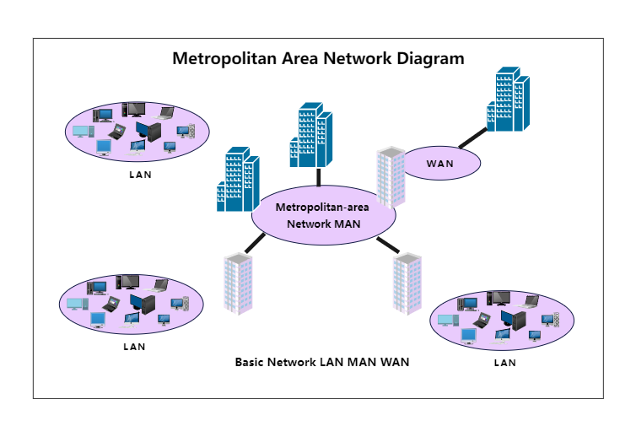
MAN:-Metropolitan area network
A Metropolitan Area Network (MAN) covers a larger area than a LAN but smaller than a WAN — typically a city or a large campus. It connects multiple LANs within a city or metropolitan region, often using high-speed infrastructure like fiber optics.

Slide 7
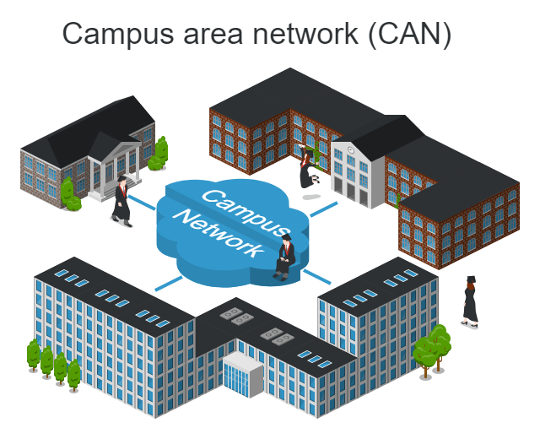
CAN:-campus area network
A Campus Area Network (CAN) is a type of computer network that connects multiple LANs within a limited geographic area, such as a university campus, business campus, or military base. It's larger than a LAN but smaller than a MAN and typically privately owned.

Slide 8
IP ADDRESS

Slide 9
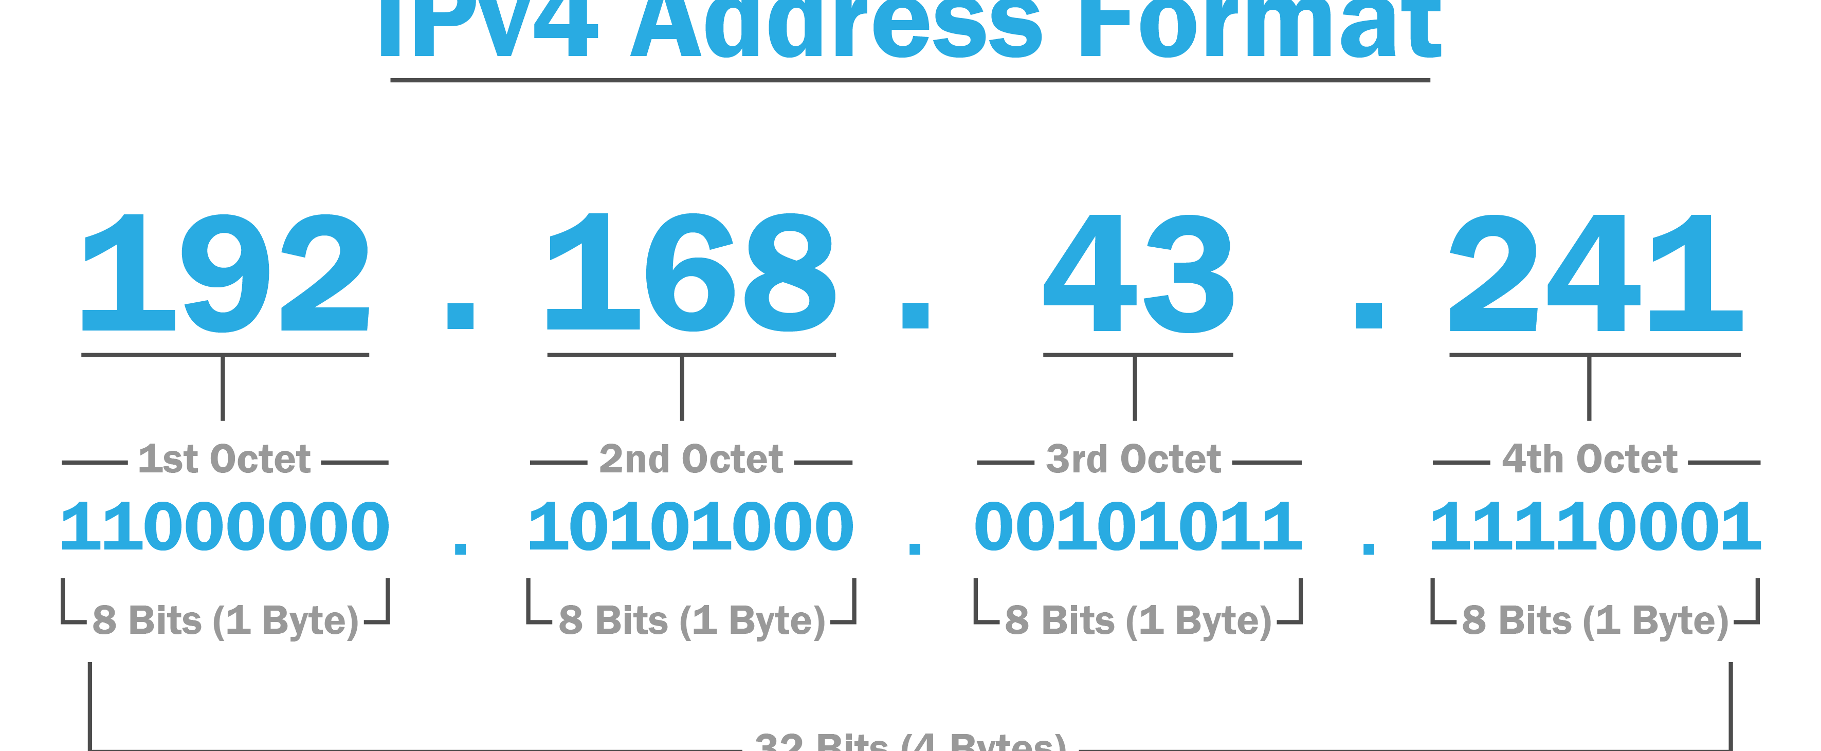
IPV 4:-
IPv4 (Internet Protocol version 4)
Format: 32-bit number (e.g., 192.168.1.1)
Written as: Four decimal numbers separated by dots
Range: 0.0.0.0 to 255.255.255.255

Slide 10
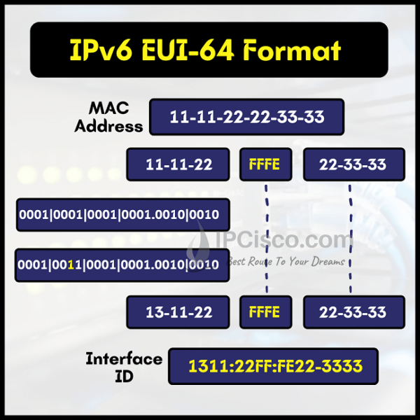
IPV6
IPv6 (Internet Protocol version 6)
Format: 128-bit number
(e.g., 2001:0db8:85a3:0000:0000:8a2e:0370:7334)
Written as: Eight groups of four hexadecimal digits
Supports: 340 undecillion (3.4×10³⁸) addresses

Slide 11
TOPOLOGY

Slide 12
Topology | Cost | Reliability | Scalability | Use Case Example
Bus | Low | Low | Poor | Small office LANs
Star | Medium | High | Good | Home networks, schools
Ring | Medium | Medium | Poor | Some WANs, token ring LANs
Mesh | High | Very High | Excellent | Military, high-security
Tree | Medium | Medium | Good | Enterprise networks
Hybrid | High | High | Excellent | Large organizations

Slide 13
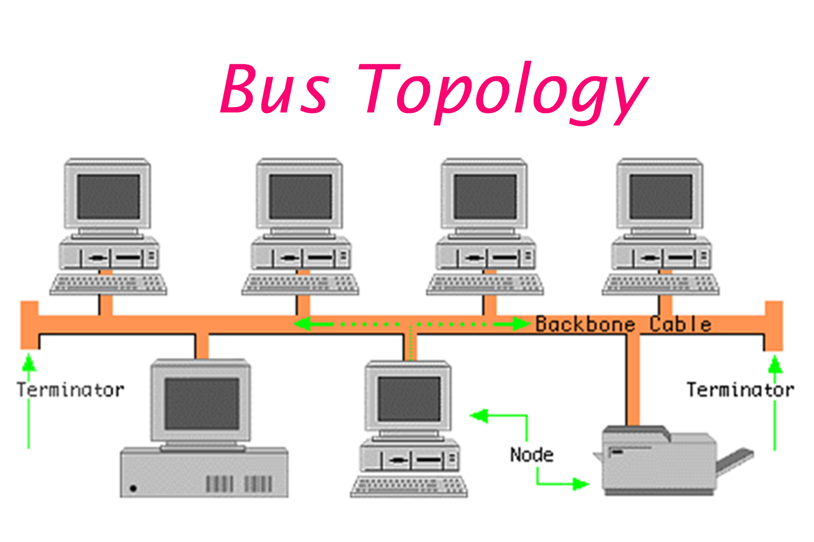
BUS TOPOLOGY:-
Structure: All devices are connected to a single central cable (the "bus").
Pros:
Easy to set up
Cost-effective
Cons:
Failure in the mainable crashes the network
Difficult to tubleshoot

Slide 14
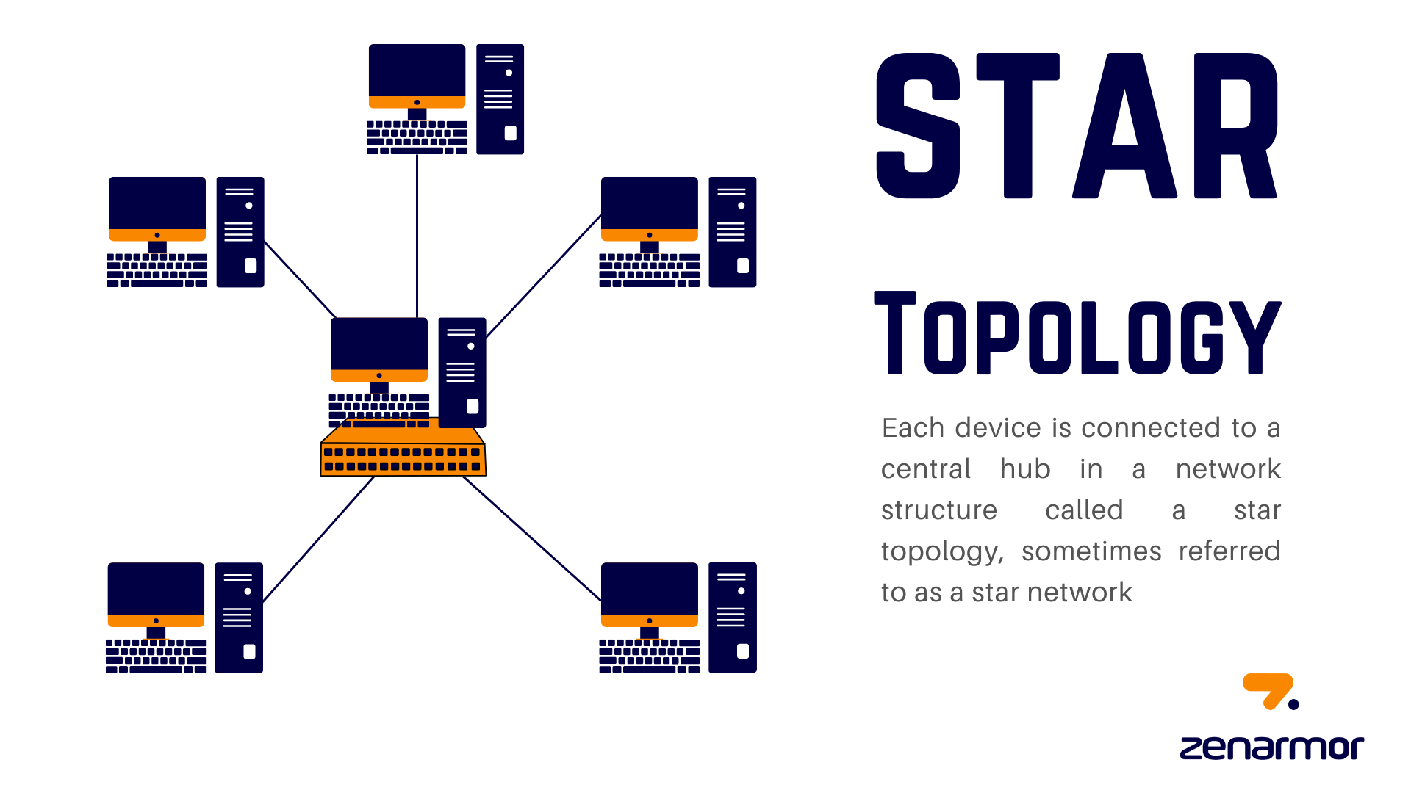
STAR TOPOLOGY:-
Star Topology is one of the most common and widely used network topologies, especially in homes, schools, and small to medium businesses.
Feature | Benefit
Easy to install | Simple setup with minimal cabling
Easy to troubleshoot | Problems can be isolated to one link
Reliable | Failure in one cable doesn’t affect the rest
Scalable | Easy to add or remove devices

Slide 15
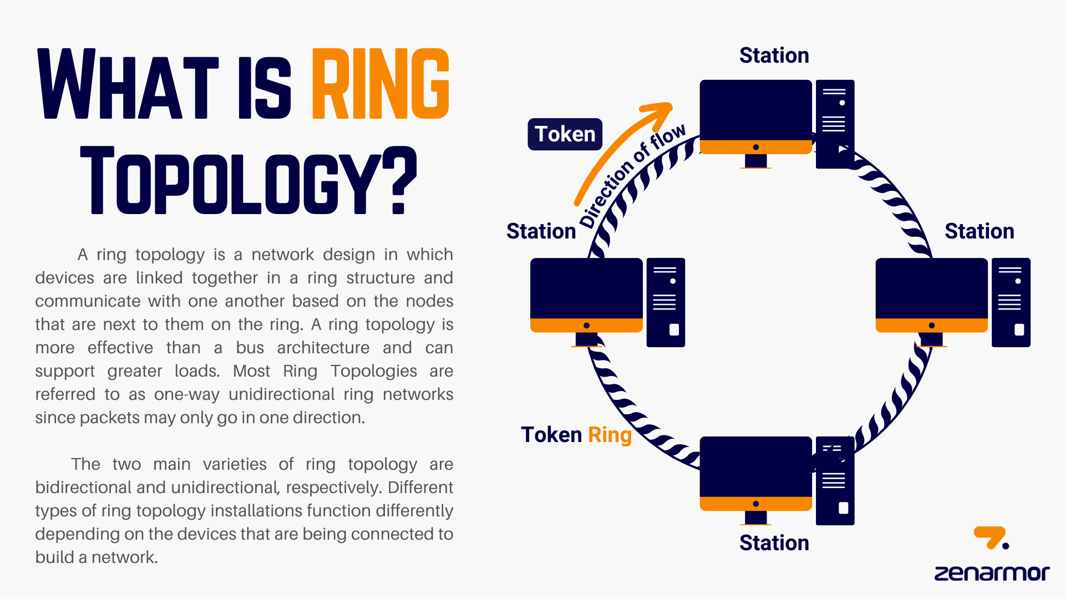
RING TOPOLOGY:-
Definition and Structure
A ring topology is a type of network configuration in which each device (or node) is connected to two other devices, creating a closed loop or circular structure. This arrangement allows data packets to travel in one direction (unidirectional) or both directions (bidirectional) around the ring. In a unidirectional ring, data flows in a single direction, while in a bidirectional ring, data can flow in both directions, enhancing reliability.
Pros:
Equal access for all devices
Cons:
A single break can bring down the network
Slower than star topology

Slide 16
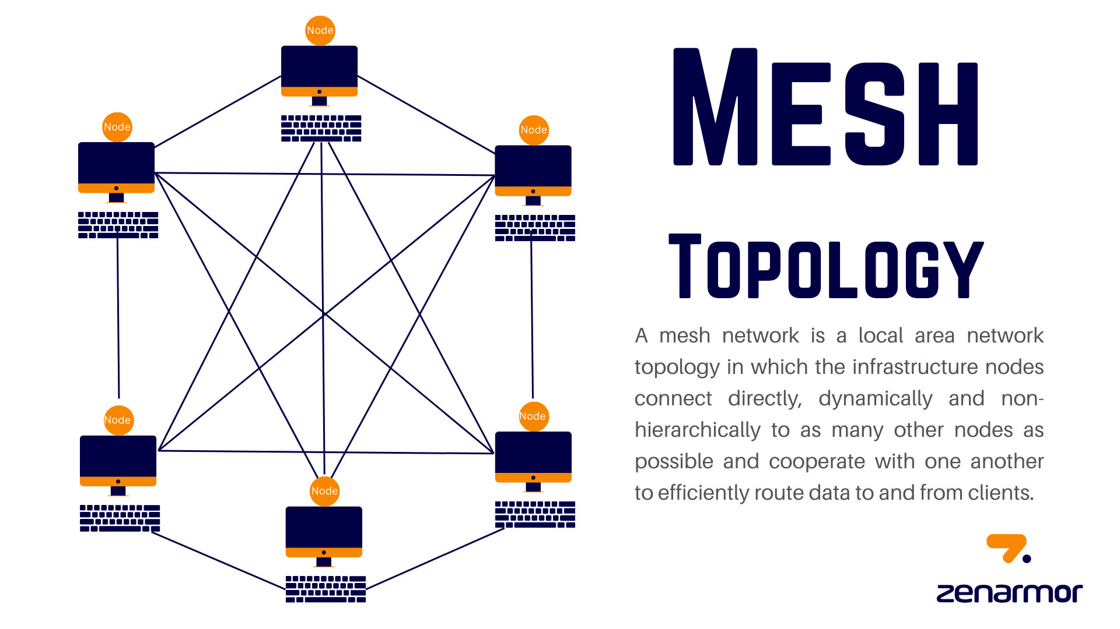
MESH TOPOLOGY:-
Structure:
Every device is connected to every other device.
Pros:
Highly reliable
Redundant paths
Cons:
Expensive and complex

Slide 17
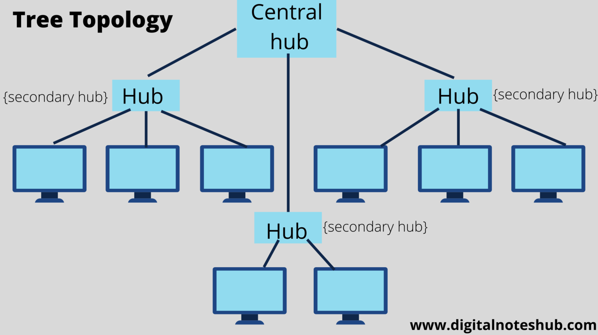
TREE TOPOLOGY:-
Structure:
A combination of star and bus topologies
Pros:
Scalable
Easy fault detection
Cons:
Main hub failure brings down the network
.

Slide 18
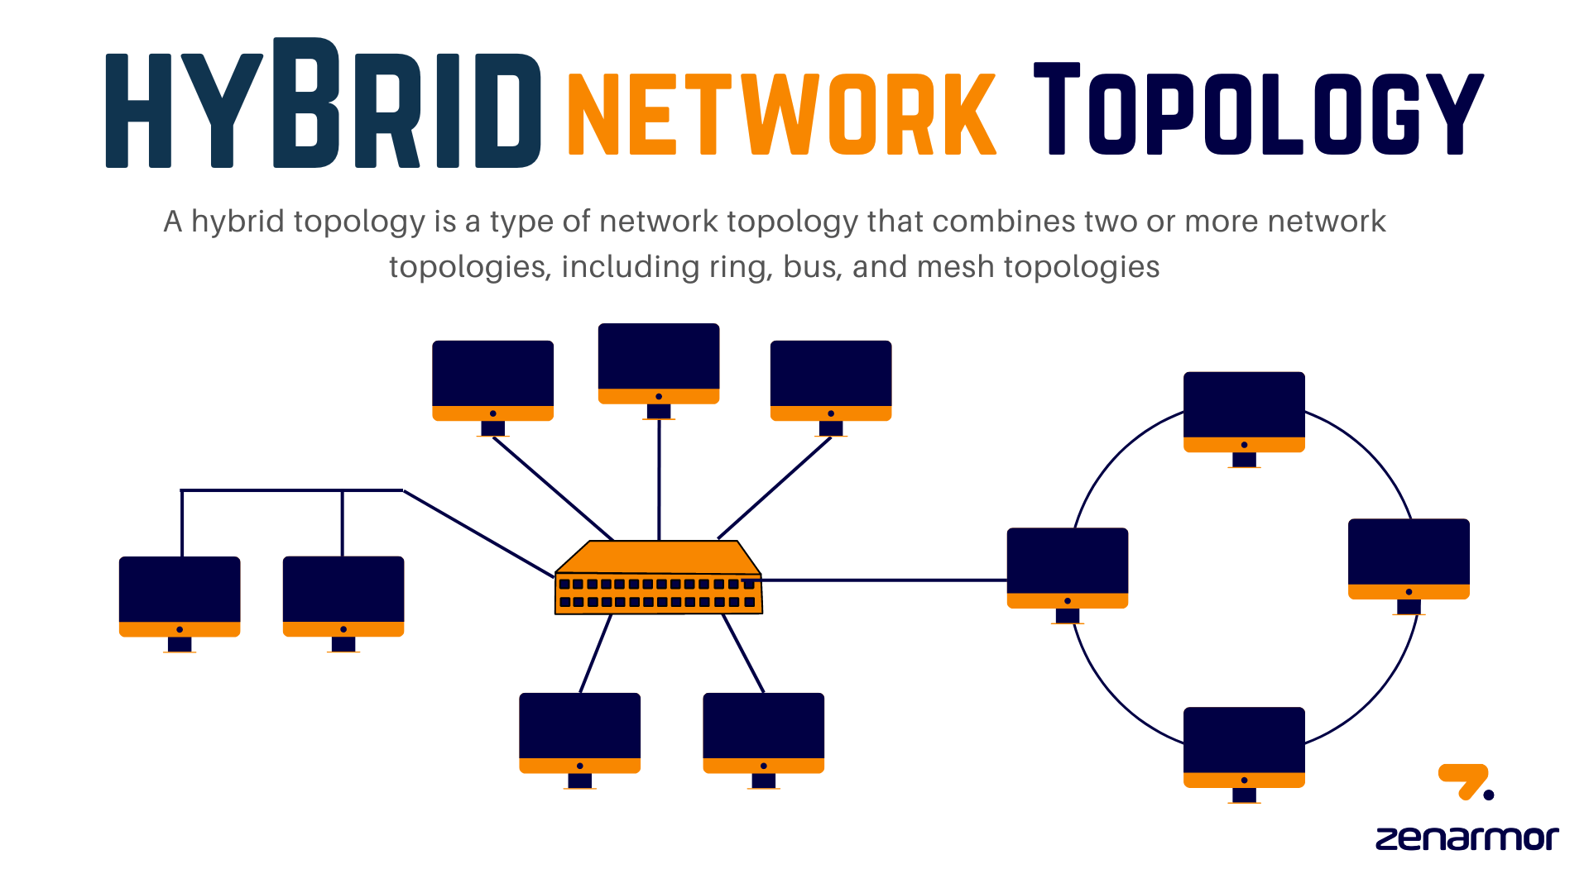
HYBRID TOPOLOGY:-
Structure: Mix of two or more topologies (e.g., star + ring).
Pros:
Flexible and scalable
Cons:
Expensive and complex to maintain

Slide 19
OSI MODEL

Slide 20
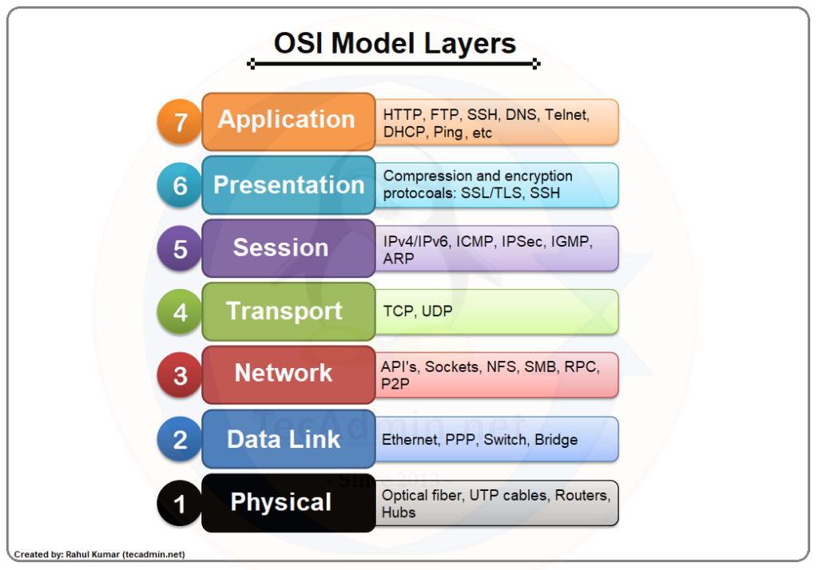
OSI LAYERS:-

Slide 21
Physical Layer
Transfers raw bits over the physical medium
Cables, electrical signals, fiber optics
Data Link Layer
Handles MAC addresses, switches, and frame delivery
Detects and corrects errors in physical layer
Network Layer
Handles logical addressing and routing
IP addresses, routers
Transport Layer
Ensures reliable transmission of data
Manages error checking, retransmissions

Slide 22
Session Layer
Maintains communication sessions
Opens, uses, and closes sessions between systems
Presentation Layer
Translates data between the application and network
Handles encryption, compression, and encoding
Application Layer
Closest to the end-user
Provides network services like email, browsing, etc.

